Slide 1







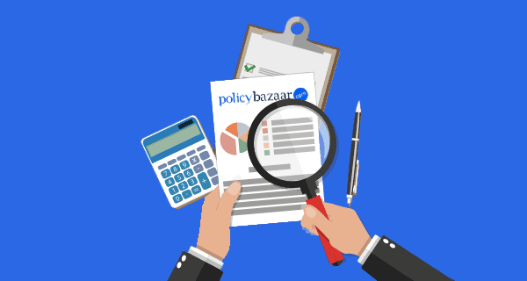
ICICI Prudential iProtect Smart Plus

Slide 2
Insurer History & Branding
ICICI Prudential Life Insurance Company (began its operations in year 2000) is a joint venture between ICICI Bank - one of India's foremost financial services companies - and Prudential.
Prudential is a British multinational life insurance and financial services company headquartered in London, United Kingdom. It was founded in London in May 1848 to provide loans to professional and working people. Prudential has 20 million life customers.
Joint Venture between | Established in | Headquarter in | Stakeholding
ICICI Bank | 1994 | Mumbai | 74%
Prudential Plc | 1848 | London (UK) | 26%
In India, ICICI Prudential (IPRU) launched first private life insurance in 2000
Claim Settlement Ratio: 99.3%
Solvency Ratio: 2
Highest Death Claim Amount paid in FY 23-24: 1867 Crores INR

Slide 3
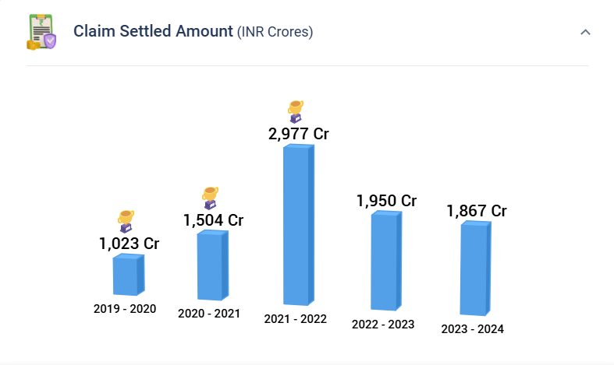
Claims Story of Ipru – Highest claims settled
Sir/Mam, The most important element in Term insurance is claim process and brand trust!
There are top brands like ICICI/HDFC/Max/Tata and out of all these brands, ICICI Prudential stands out with a big brand name of association with ICICI bank and has settled highest claims of ~2000 cr. in the last year.
Even during Covid, ICICI stood out with highest claim settled amount
Name of the Insurer | Claim Settled Amount
Ipru | 1,867
HDFC | 1,584
Max | 1,254
Tata | 1,086
Bajaj | 615

Slide 4

100% Genuine Claims Assurance Certificate

Slide 5
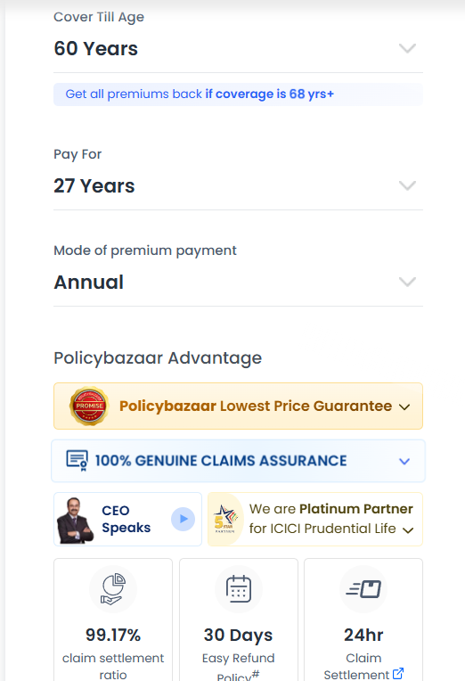
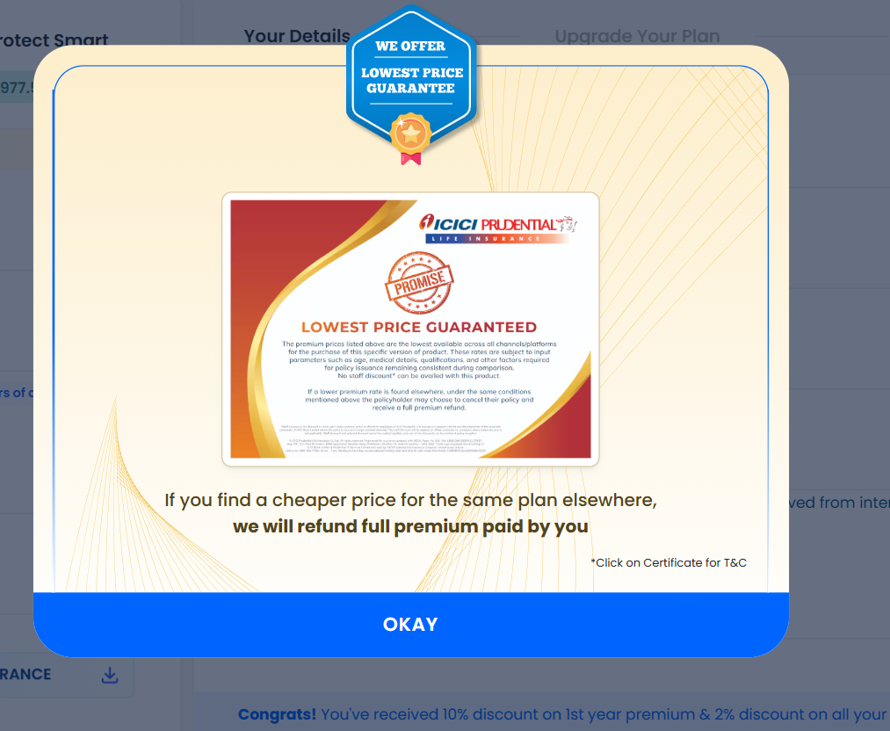
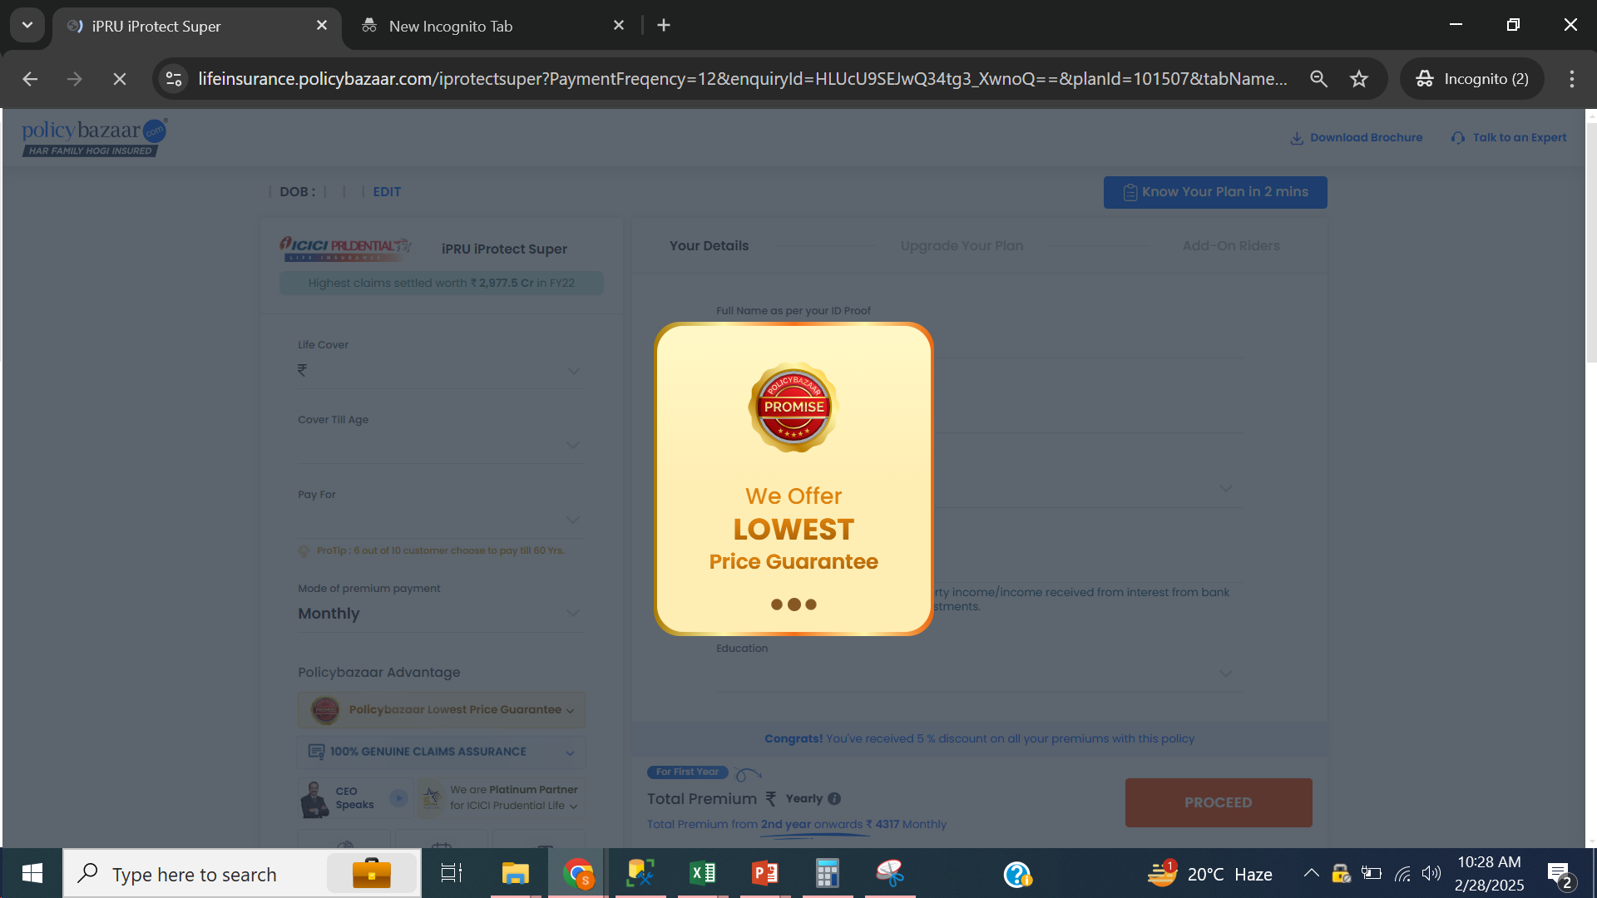
Lowest Price Guarantee
Sir/Mam, this plan has been certified by the insurer that it is the cheapest and they are saying that you can get your premium back if you find a cheaper plan elsewhere
How to view the certificate

Slide 6
Eligibility Criteria
Parameters | Description (Subject to revision as per insurer guidelines)
Entry Age | 18 - 60 yrs
Maximum Maturity Age | Pure: Upto 85 & below or 99 yrs (Whole Life)
Policy Term | Minimum: 5 yrs Maximum: Maturity Age - Entry Age
Premium Payment Term | Regular , Limited: Pay for 5, 7, 10, 15, Pay till 60 yrs of age PT - 5 and Single: PT < = 20yrs
Premium Payment Frequency | Monthly, Half Yearly & Yearly

Slide 7
Boundary Conditions: Annual Income & Education
PIN Codes are integrated in PB Website. | Minimum Education | Minimum Annual Income - SALARIED |  | Minimum Annual Income - SELF EMPLOYED |  | Occupation Allowed
 |  | Graduate & Above | Below Graduate | Graduate & Above | Below Graduate
Top 150 cities | Graduate | SA = 50L: 3L to 4.99L SA <= 1CR: 5L to 9.99L SA > 1CR: 10L & Above | 12th Pass Min SA = 1CR AI: 5L | SA <= 1CR: 5L to 9.99L SA > 1 CR: 10L & Above | 12th Pass Min SA = 1CR AI: 5L | Salaried, Self Employed, Professional
Other location apart from Top 150 Cities | Graduate | SA <= 1CR: 5L to 9.99L SA > 1CR: 10L & Above | 12th Pass Min SA = 1CR AI: 5L | SA <= 1CR: 8L SA > 1CR: Not available | 12th Pass Fix SA = 1CR AI: 5L | Salaried, Self Employed, Professional

Slide 8

SA Payout to Nominee

Slide 9

SA Payout to Nominee
S no | SA/Death Benefit Variants | SA/Death Benefit Details
1 | Lumpsum | 100% of Base SA
2 | Income | 100% Base SA divided by 120 (10 Years * 12 Months) & will be given as monthly income for 10/20/30 years.
3 | Increasing Income | 100% SA divided by 120 (10 Years * 12 Months) & will be given as monthly income for 1 year. From 2nd year onwards, monthly income will increase by 10% simple interest every year for remaining 9 years. Note: Total Payout Eligibility (HLV) will be checked at the time of policy issuance.
4 | Lumpsum + Income | 5% to 95% of SA (chosen at inception) will be given on demise as lumpsum and the remaining SA will be given as monthly income every month for 10/20/30 years.

Slide 10
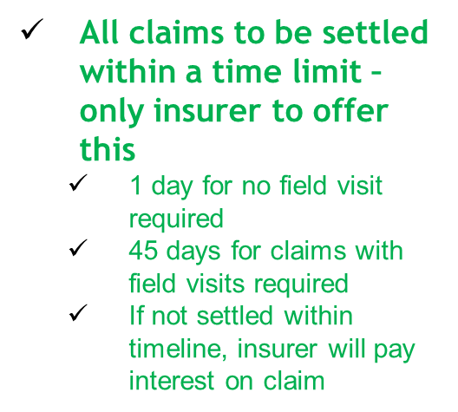
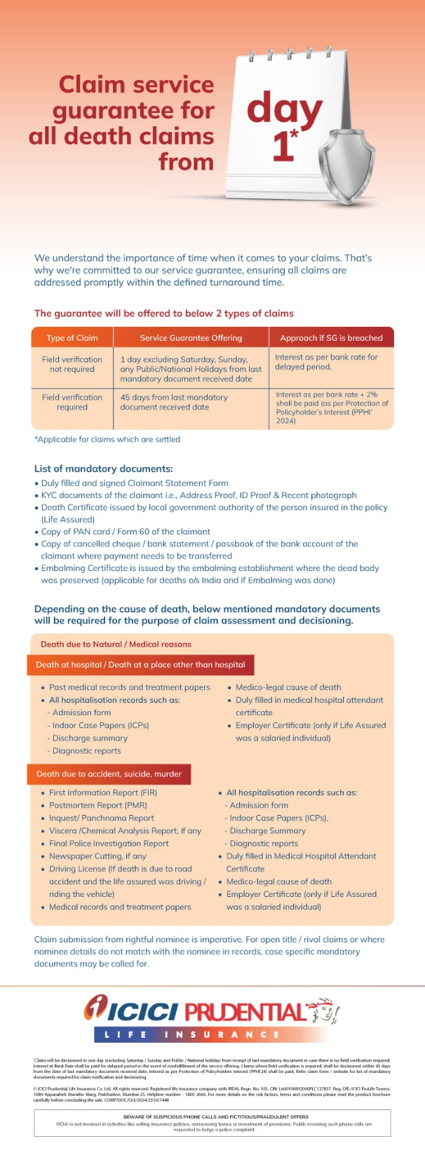
Claim Service Guarantee
Field visits would be made on early claims (within 3 yrs of policy issuance)

Slide 11





Riders
Accidental Death Benefit
3. Accidental Disability
3. Critical Illness
Terminal Illness
4. Waiver of premium

Slide 12


Riders
Additional Riders | Available | Inbuilt, Free | Optional, Paid
Accidental Death Benefit | Yes
Critical Illness | Yes
Terminal Illness | Yes
Accelerated Critical Illness | No
Waiver of Premium | No
Hospicare Rider | Yes
Parental Income | Yes

Slide 13

Rider 1
Accidental Death Benefit: (Optional, Paid)
Accidental Death Benefit Rider covers the policyholder against accidental death. 100% of the Rider SA shall be paid in case of death due to accident.
Condition: Policy holder dies on the spot of accident or within 180 days from the date of accident.
Payout: Rider SA is over & above Base SA.
Note: Rider SA cannot be more than Base SA.

Slide 14

Rider 2
Critical Illness: (Optional, Paid)
A critical illness rider is a beneficial rider who helps the policyholder financially in case they are diagnosed with a critical illness during the policy tenure.
Critical illness is a life-threatening disease such as cancer, stroke, kidney failure, etc.
This rider covers 60 or 20 Critical Illness and rider SA shall be paid on diagnosis of any 1 of the listed Critical Illness.
Conditions:
1. Waiting Period: 90 days
2. Survival Period: 15 days
Payout: Rider SA will be over and above
Note: Rider SA cannot be more than Base SA. (maximum limit 1.5cr)

Slide 15

Rider 3
Terminal Illness: (Inbuilt, Free)
If any 2 Indian Medical Association (IMA) certified doctors declare that the policyholder will die in the coming 180 days (6 months) because of any disease, Terminal Illness Rider will provide the Basic SA of Term Plan to the insured/nominee before the death, and the plan will be terminated.
Note: Doctor should not belong to policy holder’s family. AIDS/HIV is not covered.
Payout: 100% of Base SA will be paid.

Slide 16




Additional Benefits

Slide 17
Additional Benefits
Additional Benefit | Available | Inbuilt, Free | Optional, Paid
Full refund of premium | Yes
Housewife | Yes
Life stage benefit | Yes
Voluntary Top up | No
Premium break | No
Discount on Premium | Yes
Cover continuous benefit | Yes
Claim Intimation | Yes

Slide 18

Full Refund Of Premium
“Sir , with this benefit , you can protect your family & also Exit the policy or end the policy if your all responsibility has been over and get your Paid Premiums Back ( without the GST & Loading Premiums).
This implies that the plan served the purpose when you needed it for Family Protection . And when you don’t need it anymore, you can exit it by getting your paid premium back, making it a Full Refund of Premium Plan”

Slide 19
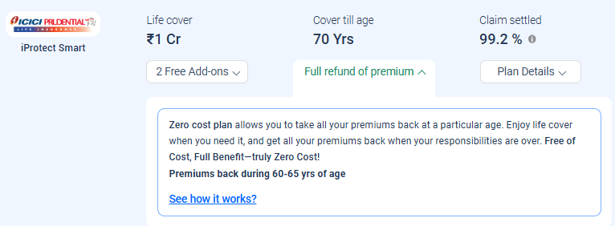
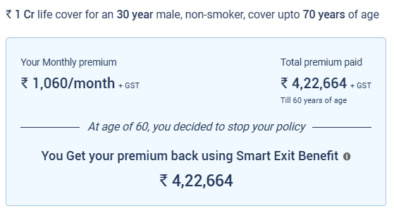
Full Refund of Premium
Minimum cover till age should be 65 and minimum Policy Term should be 31 yrs.
Minimum age to exercise is 60 or policy year >=26 except last 5 policy years
Example: A 30-year-old, buys a policy with SA 1 Cr, Cover upto 70 Years
Sir/Mam, now term plans offer a unique feature of getting back your premium once your financial responsibilities are over at no additional cost

Slide 20

Additional Benefit 3
Housewife Cover

Slide 21
Additional Benefit 3
Housewife Cover:
Min SA for HW | Max SA for HW | Max SA for HW (Dependent on husband's SA) | Husband needs to have an existing Term Plan, from any insurer | Husband's Financial Eligibility checked | Husband's Education
25L | 50L | Yes | Yes Husband's existing policy should be Twice the Cover of Housewife | No HW Plan can be taken even if he has maxed out his existing HLV with his current Term Plan | Graduate
Housewife's Education [Proof not needed at issuance] | Husband's Minimum Annual Income | Surrogate | PAN & Aadhar Card Card of HW | Tax Benefits under Sec 80 C | Rider
Graduate | AI - 8 L with income proof | No | Mandatory | Either Husband or wife can get the Tax Benefit | TI & WOP

Slide 22
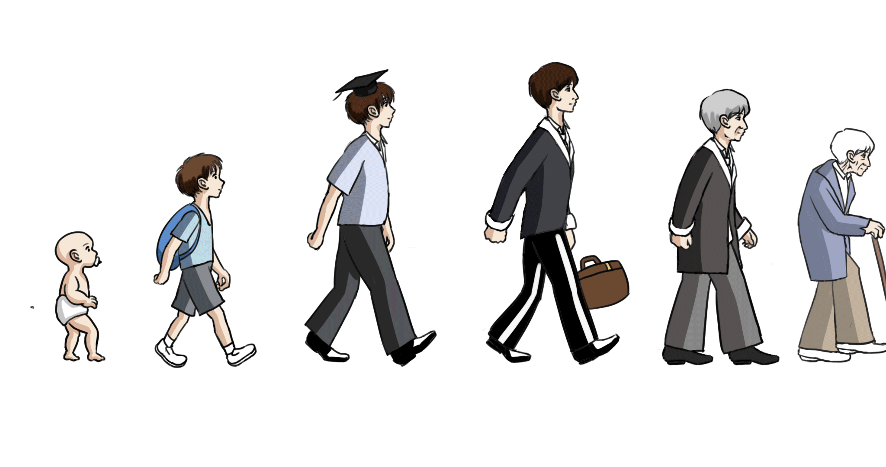
Additional Benefit 4
Life Stage Benefit (LSB): Responsibilities increase with time. Only Basic SA can be increased at important Stages of Life by a female/male policyholder.
LSB is used to increase the SA in different stages of policy holder’s life:
1st Marriage after policy issuance: 50% of Base SA, Max 50 L
Birth of 1st child after policy issuance: 25% of Base SA, Max 25 L
Birth of 2nd child after policy issuance: 25% of Base SA, Max 25 L
Home Loan Disbursement 100% To avail LSB, policy holder has to inform insurer within 180 days of the event, with proof of the event
1. If policy holder is interested for LSB, then LSB has to be added to the policy at the time of inception/buying the policy. 2. HLV is checked at the inception for the Base SA & the increased SA of LSB. 3. Premium doesn’t increase at the time of adding LSB to the policy. 4. Premium increases when customer uses LSB during the policy term.

Slide 23
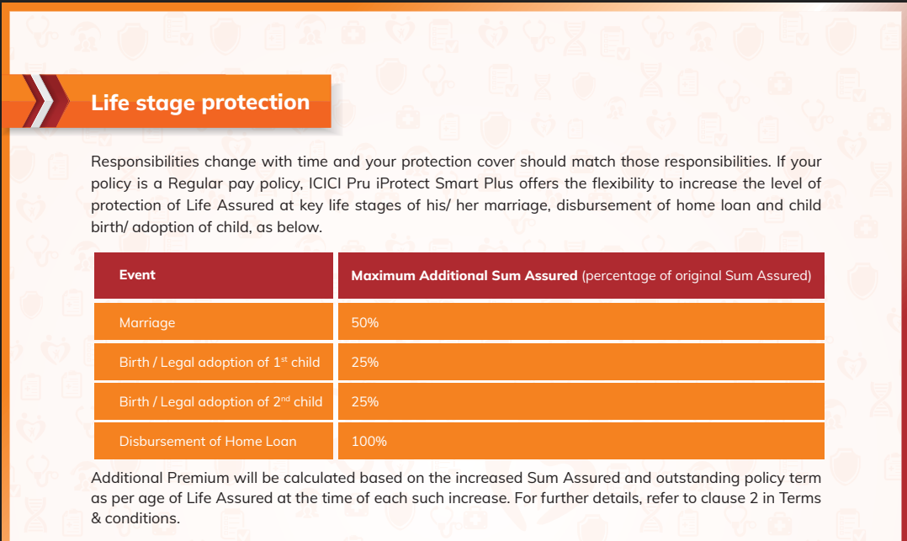
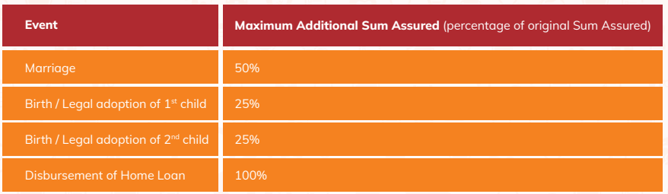

Slide 24
Additional Benefit 4
Life Stage Benefit (LSB): 4. Premium increases when customer uses LSB during the policy term. 5. Additional premium will be calculated based on the increased SA & outstanding policy term as per insured's age at the time of such increase. Additional premium will be calculated basis the customer’s current age (when s/he is using the LSB).
6. LSB can only be used if insured has not taken any claim under any benefit in the past. 7. At the time of using LSB, policy holder’s age should be less than 50.
8. LSB is not to add spouse or child in the same policy, it is to increase the Base SA of insured person at specific events.
Note: At the time of increasing Base SA under LSB, policy holder won’t undergo Financial Documentation or Financial Eligibility Check. Medical Underwriting may happen.

Slide 25
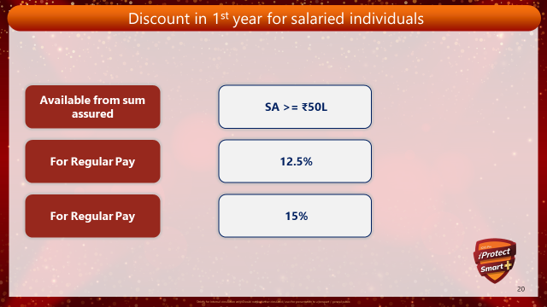
Additional Benefit 2
Discount Parameters | Salaried | Self Employed
On 1st Year Premium | 10% Discount on Regular Pay ( SA => 1Cr) | NA
 | 15% Discount on Limited Pay ( SA => 1Cr) | NA
Online Discount | Upto 5% Lifetime Online Discount | Upto 5% Lifetime Online Discount

Slide 26
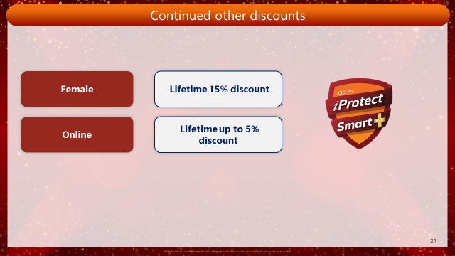
Extra

Slide 27

Cover Continuous Benefit
Can be opted after 5 policy years
Can be opted multiple times at a gap of minimum 5 years
Cannot be opted in the last 3 years of premium payment
Cover continues during premium break period
Customer has to inform at least 30 days before premium due date
Unpaid premiums to be paid in next premium installment

Slide 28
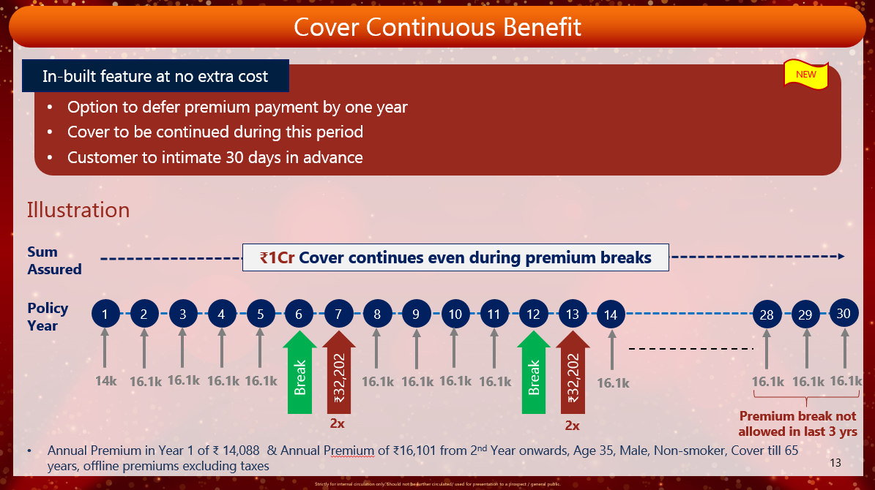

Slide 29
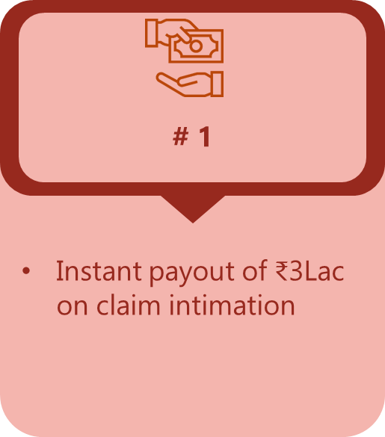
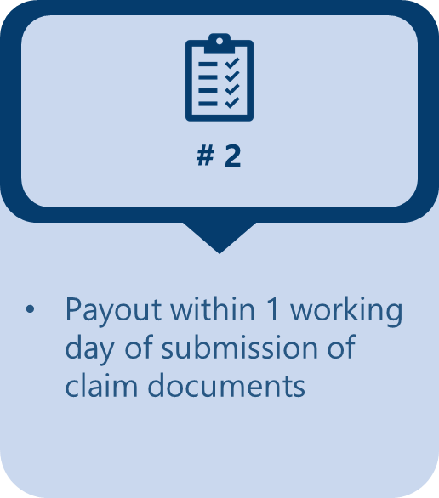
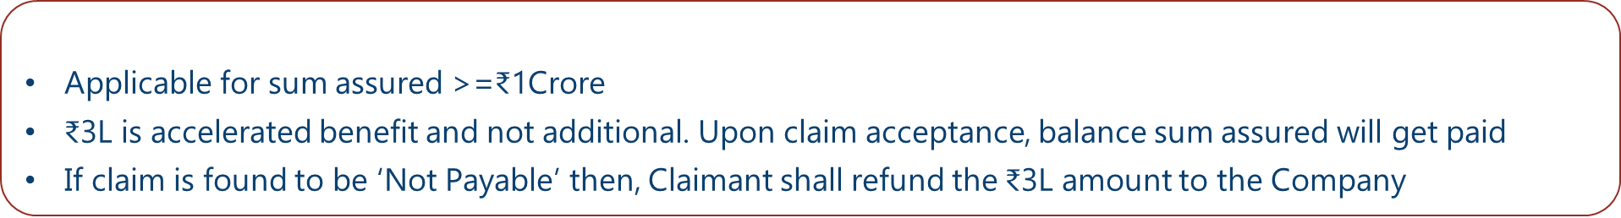

Slide 30
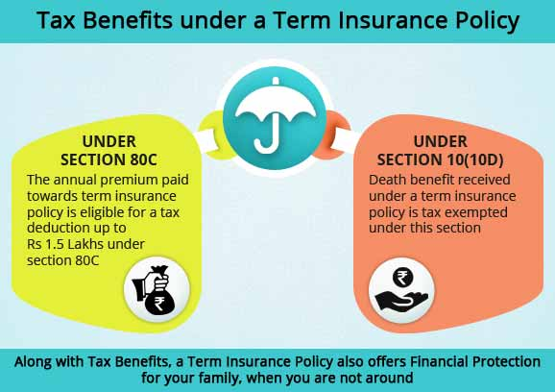
Taxation

Slide 31
Term & Conditions
Free Look Up Period | 30 days from the day customer receives the policy document/bond
Grace Period | 30 days from the premium due date – Y/H/Q PPF 15 days from the premium due date – Monthly PPF
Reinstatement or, Revival Period | 5 Years from the due date of the first unpaid premium & before the termination date of the policy

Slide 32


On-Call Sales Pitch (USP)
ICICI is the largest private sector bank in India
One of the biggest Life Insurance Company in India
Highest Claim Paid Amount in FY 22-23 i.e 1867 Crores
Claim Settlement Ratio is more than 99.3%
471+ branches across India
Discount: Upto 5% Online discount available for lifetime
Zero Cost: Exit anytime from 26th policy year onwards
but not in last 5 years

Slide 33



